Slide 1
Running Hadoop Clusters on Azure
Ben Humphrey
Email: behumphr@microsoft.com | Twitter: @AzureNerd

Slide 2
Agenda
Major Hadoop Distributions on Azure
IaaS vs. PaaS Hadoop Tradeoffs
Security
Hortonworks Data Platform
Cloudera CDH and Enterprise Platform
High Availability and Backup

Slide 3
Major Hadoop Distributions on Azure

Slide 4




Major Hadoop Big Data Platforms

Slide 5





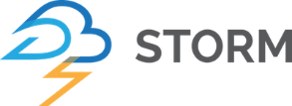


Cloudera Manager / Cloudera Director
Cluster Management and Monitoring UI
Sentry / Cloudera Navigator
Security and Auditing
Sqoop
RDBMS Exchange
Spark
SQL / Streaming
Impala
Fast SQL Querying
Pig
Scripting / ETL
Storm
Streaming
HIVE
SQL Language
Oozie
Workflow / Automation
Cloudera Search
Search
Mahout
Machine Learning
HBASE
Columnar Store
Cloudera Ecosystem
Zookeeper
HA / Distributed Coordination of Resources
YARN (MapReduce V2)
Yet Another Resource Negotiator / Manager
Flume
Log Collector
HDFS
Hadoop Distributed File System
Notes:
The Hadoop ecosystem is quite complex and has numerous projects that each facilitate a different function. Is it any wonder that people see all the animal names and run away because it’s so much to tackle? It takes some very specialized skills to be able to setup, maintain and optimize a Hadoop cluster. This slide isn’t meant to scare you, but to help you appreciate all the things that go into working with a Big Data framework.

Slide 6

Ambari
Cluster Management and Monitoring UI
Knox / Ranger
Security and Auditing
Sqoop
RDBMS Exchange
Spark
SQL / Streaming
Falcon
Data Governance
Pig
Scripting / ETL
Storm
Streaming
HIVE
SQL Language
Oozie
Workflow / Automation
HDPSearch
Search
Mahout
Machine Learning
HBASE
Columnar Store
Hortonworks Ecosystem
Zookeeper
HA / Distributed Coordination of Resources
YARN (MapReduce V2)
Yet Another Resource Negotiator / Manager
Flume
Log Collector
HDFS
Hadoop Distributed File System
Notes:
The Hadoop ecosystem is quite complex and has numerous projects that each facilitate a different function. Is it any wonder that people see all the animal names and run away because it’s so much to tackle? It takes some very specialized skills to be able to setup, maintain and optimize a Hadoop cluster. This slide isn’t meant to scare you, but to help you appreciate all the things that go into working with a Big Data framework.

Slide 7
IaaS vs. PaaS Hadoop Tradeoffs

Slide 8
HDI Benefits to Consider vs. IaaS
Much Cheaper
16TB of Blob Storage (WASB) vs. 16TB of SSDs almost 1/10th cheaper
Less Management of the Cluster
Spinning up and down clusters is very easy
If nodes go down they self heal
Orchestration with Azure Data Factory to spin up clusters on demand
Storage Available When Cluster is Absent
If the cluster is destroyed the data is still available
Copy terabytes of data to Blob Storage without paying for compute
Remove a Cluster and Recreate for Latest Updates
Just recreate the cluster to get the latest updates and services
Hadoop Support Built In
Support plans include Hadoop support when using HDInsight

Slide 9
IaaS Benefits to Consider vs. HDI
Premium Storage (SSDs)
Greater throughput speed and lower latency
A more familiar disk-based setup that you might already have on-prem
Security Options
Options to use Sentry (Cloudera), Ranger (HW) or Knox (HW)
Options for Azure Disk Encryption or 3rd party extensions
Impala Options
Impala doesn’t currently support WASB storage
Additional Backup Options
VMs can take advantage of Azure Backup or other 3rd party solutions
Cloudera has BDR, a Backup and Disaster Recovery product
Shutdown Capabilities
With VMs you can shut them down and turn on quicker

Slide 10
Security

Slide 11
Security Options
Authentication
Cloudera supports Kerberos for AD/LDAP and SAML
Hortonworks uses Knox for AD/LDAP and SAML
Encryption
Azure Disk Encryption (non-premium disks) or 3rd party software
Azure Secure Storage Encryption (Preview)
Azure Key Vault, Navigator Key Trustee Server (Cloudera) and Ranger (HW)
SSL and Intra-cluster SSL encryption can be turned on (very slow)
Authorization
Cloudera uses Sentry for fine-grained access control and RBAC
Hortonworks uses Ranger for fine-grained access control and RBAC
Auditing
Cloudera Navigator provides auditing and data lineage
Apache Ranger in Hortonworks provides auditing

Slide 12
Hortonworks Data Platform

Slide 13
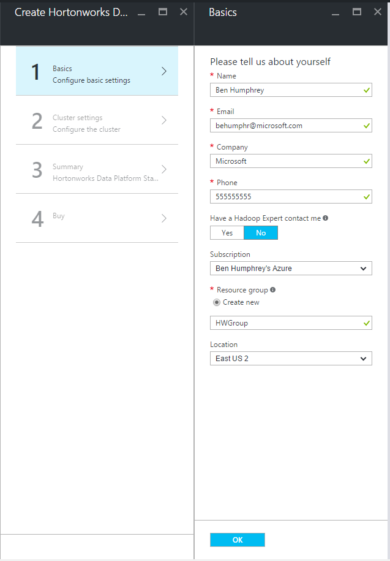
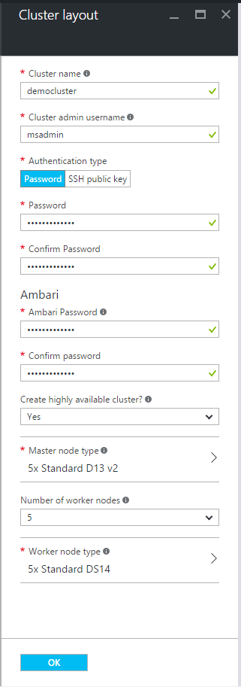
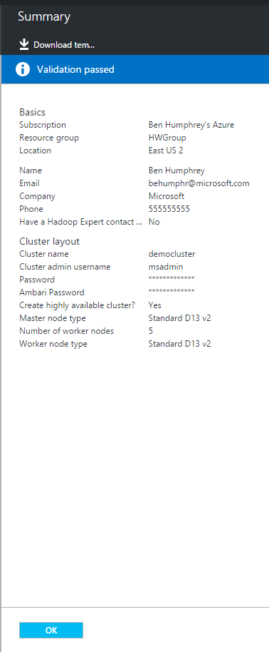
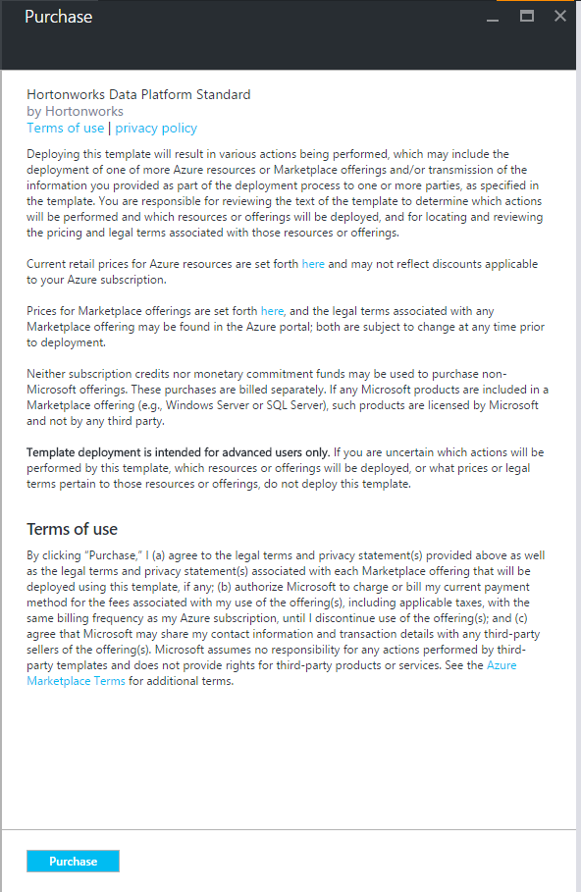
Hortonworks Deployment

Slide 14
Spinning up a Hortonworks cluster in Azure

Slide 15
Cloudera Enterprise Platform

Slide 16
Spinning up a Cloudera cluster in Azure

Slide 17
High Availability and Disaster Recovery

Slide 18
High Availability Considerations
Database: MySQL HA and PostgreSQL HA best practices
Hive Metastore: DBTokenStore class and standard HA for the DB
HDFS: 2 NameNodes, 3 ZooKeepers and 3 JournalNodes
YARN: 2 Resource Managers
Oozie, Hive Server 2, Hue, Impala: 2 instances Load Balanced
Head, Worker and Utility/Edge nodes go in Availability Sets
Limit for Availability Sets is 100 VMs by default, can go up to 200
Rack Awareness
Replication of Worker nodes need to be spread across Fault/Update Domains so an update doesn’t kill jobs
Can be done through a script or Cloudera Manager manually

Slide 19
Disaster Recovery Options
Distcp to another cluster/WASB with Falcon/Oozie jobs
BDR Product (Cloudera) – Uses Distcp under the hood
Falcon Data Mirroring (HDFS, Blog Storage and S3)
HBase replication across clusters
Azure SQL Database replication
WANDisco claims to have active replication support
Notes:
HBase replication: http://www.cloudera.com/documentation/archive/cdh/4-x/4-2-0/CDH4-Installation-Guide/cdh4ig_topic_20_11.html
HDI: https://azure.microsoft.com/en-us/documentation/articles/hdinsight-hbase-geo-replication/
Falcon Data Mirroring: http://docs.hortonworks.com/HDPDocuments/HDP2/HDP-2.3.0/bk_data_governance/content/section_mirroring_data_falcon.html

Slide 20
Summary
TODO

Slide 21
Thank you!
We value your feedback, please rate this session.
http://bit.ly/TODO

